Slide 1
Agentic AI Health Symptom Checker
CAPSTONE PROJECT
Presented By:
1. Sachin Chavan-Sitrc,Sandip Foundation,Nashik-Computer Engineering

Slide 2
OUTLINE
Problem Statement
Proposed System/Solution
System Development Approach
Algorithm & Deployment
Result
Conclusion
Future Scope
References

Slide 3
PROBLEM STATEMENT
In today's fast-paced world, individuals often struggle to interpret health symptoms accurately due to a lack of medical knowledge, reliable resources, and timely access to healthcare professionals.
Misinformation from unverified sources can lead to self-diagnosis risks, delayed treatment, or unnecessary panic. Additionally, language barriers and limited access to localized medical information further worsen the problem.
There is a critical need for a reliable, multilingual AI assistant that can analyze user-reported symptoms in natural language and provide:
Probable causes based on trusted medical data,
Urgency level of symptoms,
Preventive care advice and home remedies,
Guidance on when to consult a healthcare professional.
This assistant must ensure educational, referral-based suggestions — not diagnosis — to reduce misinformation and empower users to take informed health actions.

Slide 4
PROPOSED SOLUTION
We propose building a smart, user-friendly health assistant that helps individuals understand their symptoms better and take the right steps without jumping to conclusions.
The assistant will allow users to describe their symptoms in plain language — for example, "I have a headache and feel dizzy" — and will provide suggestions like:
Possible health conditions related to those symptoms,
How serious the situation might be (low, medium, high urgency),
Simple home remedies and self-care tips,
Advice on when it’s important to consult a doctor.
To ensure accuracy and safety, the assistant will pull information from verified medical databases and official health portals. It will not provide a diagnosis, but will instead give educational, referral-based guidance.
The solution will:
Be available via web or mobile interface,
Use IBM Cloud Lite and IBM Granite for AI and deployment,
Promote health awareness, early detection, and responsible action.
By combining ease of access, trusted data, and AI-powered interactions, our system bridges the gap between confusion and care — offering people clarity when they need it most.

Slide 5
SYSTEM APPROACH
System requirements
Hardware:
Processor-Intel i5 or equivalent
RAM-8 GB or higher
Storage-250 GB SSD (for dev environment)
Internet-Stable connection (5 Mbps or more)
Software:
IBM Cloud Lite - Watsonx.AI, Watsonx.runtime, py 3.11,
Git / GitHub

Slide 6
SYSTEM APPROACH
System Approach – Agentic AI Health Symptom Checker
Our approach focuses on building a reliable, user-friendly, and scalable AI health assistant by following a structured development process. The key stages include:
User Interaction & Input Processing
Users enter symptoms in natural language (e.g., “I have a sore throat and fever”)
Symptom Analysis & Matching
Extracted symptoms are compared with data fetched from google, wikipedia, webcrawler
The system maps symptoms to a list of possible conditions with associated urgency levels.
Recommendation Engine
Based on analysis, the system provides: Possible causes or conditions (informational only), home remedies and preventive care and a suggestion on whether medical attention is needed.
Deployment on IBM Cloud Lite
Models are hosted using IBM Cloud Lite services for a cost-effective and scalable infrastructure.
Safety & Reliability
The assistant avoids self-diagnosis and includes disclaimers.
Refers users to certified sources and encourages doctor visits when needed

Slide 7
ALGORITHM & DEPLOYMENT
Model Selection: LLaMA 3 70B Instruct
We used Meta’s LLaMA 3 70B Instruct model to power the natural language understanding and response generation in our health symptom checker.
Why LLaMA 3 70B?
It's highly accurate in interpreting user inputs written in natural language.
It supports multi-turn conversations and multilingual inputs, which makes it ideal for this use case.
It’s optimized for instruction-following, allowing it to stay on-topic, follow safety guidelines, and avoid offering medical diagnoses
Data Input
User-provided input includes:
Free-text symptom descriptions (e.g., “I have a fever and a sore throat”),
Optional details like age, language preference, and gender (used for context),
Internally, the system uses a curated symptom-condition reference dataset (sourced from WHO, CDC, or health portals) to supplement the model's reasoning.

Slide 8
ALGORITHM & DEPLOYMENT
Model Interaction & Processing Flow
Input Handling & Preprocessing
1. Input text is Identify symptoms. 2.Estimate urgency level. 3. Suggest safe and responsible next steps.
Model Response Generation
1. Likely causes (for awareness). 2. Home remedies or care suggestions. 3. Recommendations on when to consult a doctor.
Safety Layer
The prompt structure ensures the model avoids providing direct medical diagnoses and includes disclaimers to encourage professional consultation when needed.
Deployment Strategy
LLM - LLaMA 3 70B Instruct (via local server or inference API)
Deployment Platform - IBM Cloud Lite (Compute & Hosting

Slide 9
RESULT
The Health Symptom Checker system was successfully developed and tested with multiple user inputs in different languages. Below are the key outcomes:
Accurate Symptom Interpretation
The assistant correctly understood various natural language symptom descriptions such as: “I have chest tightness and shortness of breath” or “I’m feeling weak and have a mild fever.”
🔹 Meaningful Health Guidance
Provided users with:
A list of possible related conditions (for awareness only),
Urgency level (Low / Medium / High),
Easy-to-follow home remedies and care advice,
A recommendation on when to consult a doctor.
🔹 Multi-language Support
Successfully supported inputs and outputs in multiple languages (e.g., English, Hindi), enhancing accessibility for diverse users.

Slide 10
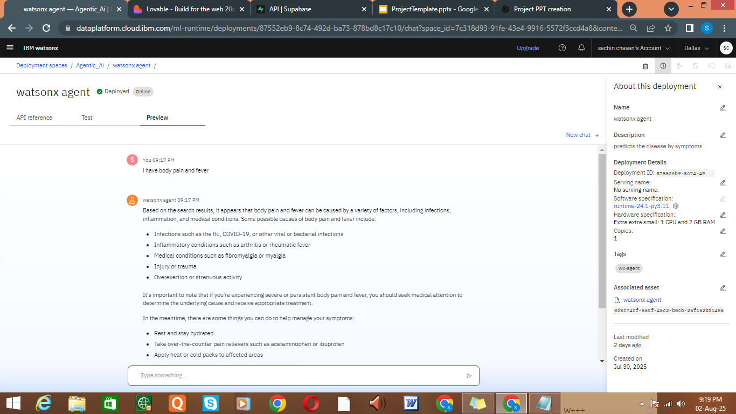
RESULT

Slide 11
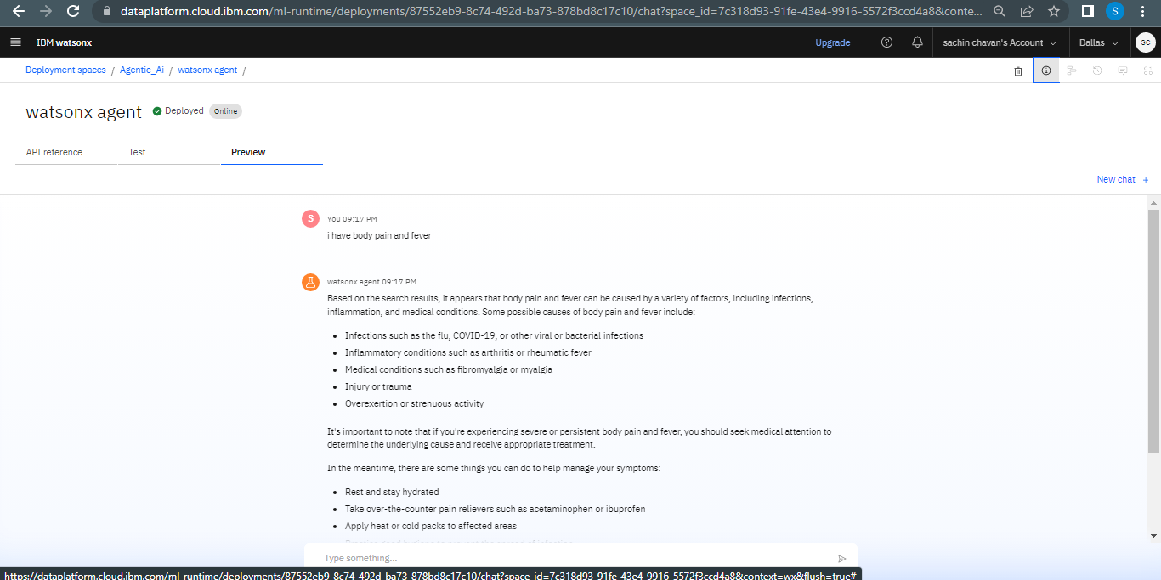
RESULT

Slide 12
CONCLUSION
The Agentic AI Health Symptom Checker successfully demonstrates how conversational AI can assist users in understanding their health conditions responsibly and reliably. By analyzing symptoms through natural language input and referencing trusted medical data, the system provides valuable guidance without replacing professional medical advice
Findings:
The assistant effectively interprets symptom descriptions and provides educational health suggestions.
Multilingual support increases the tool’s accessibility to a wider population.
Deployment using IBM Cloud Lite and IBM Granite made the solution lightweight, scalable, and fast
Challenges Faced:
Ensuring responses remain informative yet non-diagnostic required careful prompt tuning
Future Improvements:
Integrate with official APIs from WHO or government health portals for richer and real-time data.
Expand multi-language support with speech-to-text for voice inputs.
Add a feedback loop for users to rate the accuracy or helpfulness of suggestions.

Slide 13
FUTURE SCOPE
The current version of the Health Symptom Checker lays the foundation for a helpful and accessible AI health assistant. However, there are several ways the project can be expanded and improved in the future
1. Voice & Chatbot Integration
Add voice input and output for hands-free interaction.
Integrate with platforms like WhatsApp, Telegram, or hospital websites as a chatbot.
2. Regional Language Expansion
Extend support for more Indian and global languages with dialect handling.
Include regional health guidelines and common symptom expressions.
3. Real-Time Health Data Integration
Connect with APIs from WHO, Ayushman Bharat, or state health portals for up-to-date alerts and disease trends
4. Personalized Health Tracking
Suggest personalized preventive care based on user history
5. AI Model Fine-Tuning
Train the model on localized medical symptom data to improve accuracy and relevance.
Use reinforcement learning to improve output based on user feedback

Slide 14
REFERENCES
IBM Cloud Documentation
https://cloud.ibm.com/docs
– Official documentation for IBM Cloud Lite services, deployment, and security
IBM Granite Models Overview
https://research.ibm.com/blog/granite-model-family
– Detailed information on IBM Granite family for NLP tasks and multilingual support.
IBM Watsonx.ai
https://dataplatform.cloud.ibm.com/wx/home?context=wx?context=wx&locale=en
– For integrating IBM language models and building AI-driven assistants.
Agent Lab Beta
https://dataplatform.cloud.ibm.com/docs/content/wsj/analyze-data/fm-agent-lab.html?context=wx&audience=wdp&locale=en
-lite service
World Health Organization (WHO)
https://www.who.int
– Source for verified symptom descriptions and healthcare guidelines
Health NLP Best Practices – Stanford NLP Group
https://nlp.stanford.edu/projects/health-nlp

Slide 15
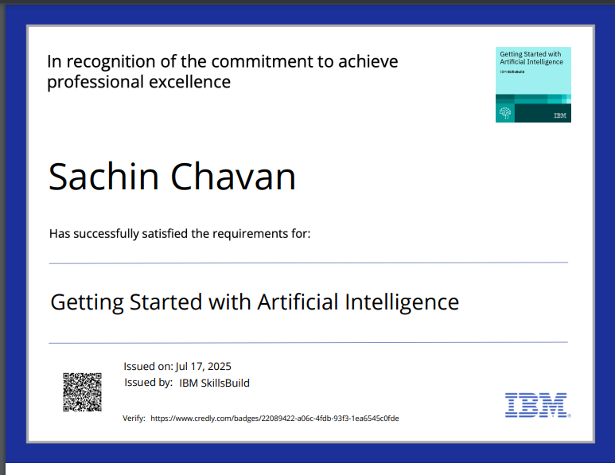
IBM CERTIFICATIONS

Slide 16
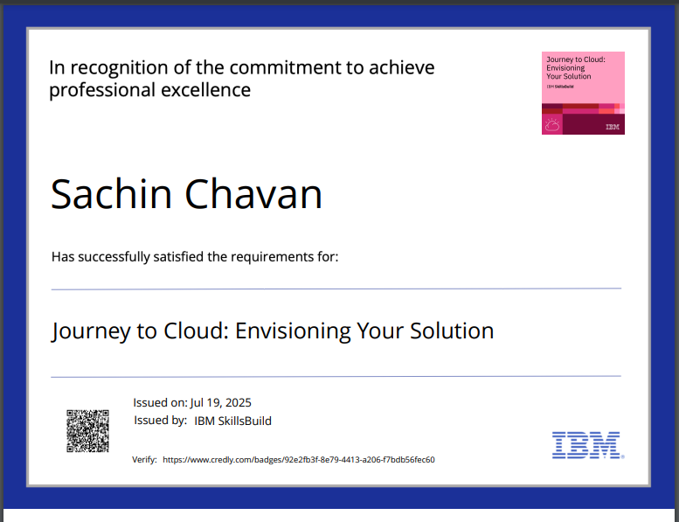
IBM CERTIFICATIONS

Slide 17
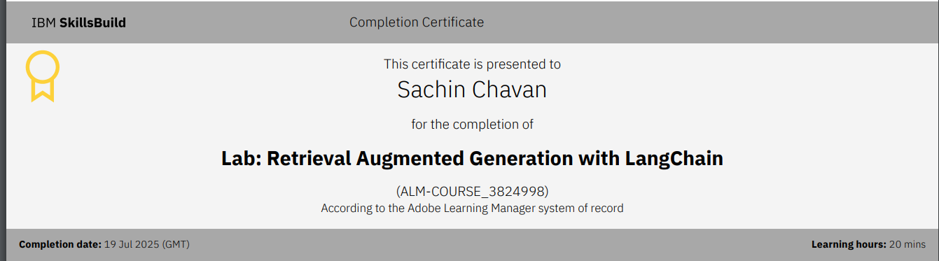
IBM CERTIFICATIONS

Slide 18
THANK YOU

